Slide 1


Introduction to Operating Systems CS 1550
Spring 2023
Sherif Khattab
ksm73@pitt.edu
(Some slides are from Silberschatz, Galvin and Gagne ©2013)

Slide 2
Announcements
Upcoming deadlines
Homework 10 due this Friday
Project 3 due this Friday at 11:59 pm
Lab 4 due next Tuesday 4/11 at 11:59 pm

Slide 3
Previous Lecture …
How to allocate disk blocks to files and directories?
contiguous

Slide 4
This lecture …
How to allocate disk blocks to files and directories?
linked, FAT, indexed, and hybrid
How does a file system handle errors?

Slide 5
Enter File System!
How to allocate disk blocks to files and directories?

Slide 6
Linked allocation
File blocks form a linked list
Blocks may be scattered around in disk
Block has pointer to next block
Files grow as large as needed
Indexing is simple
Index node contains
First and last block
Length of file in bytes
Blocks allocated as needed
Linked into list of blocks
Removed from list of free blocks (or bitmap)
No wasted blocks - all blocks can be used
0
1
2
3
4
6
4
5
6
7
x
x
8
9
10
11
0
Start=9
End=4
Length=2902
Start=3
End=6
Length=1500

Slide 7
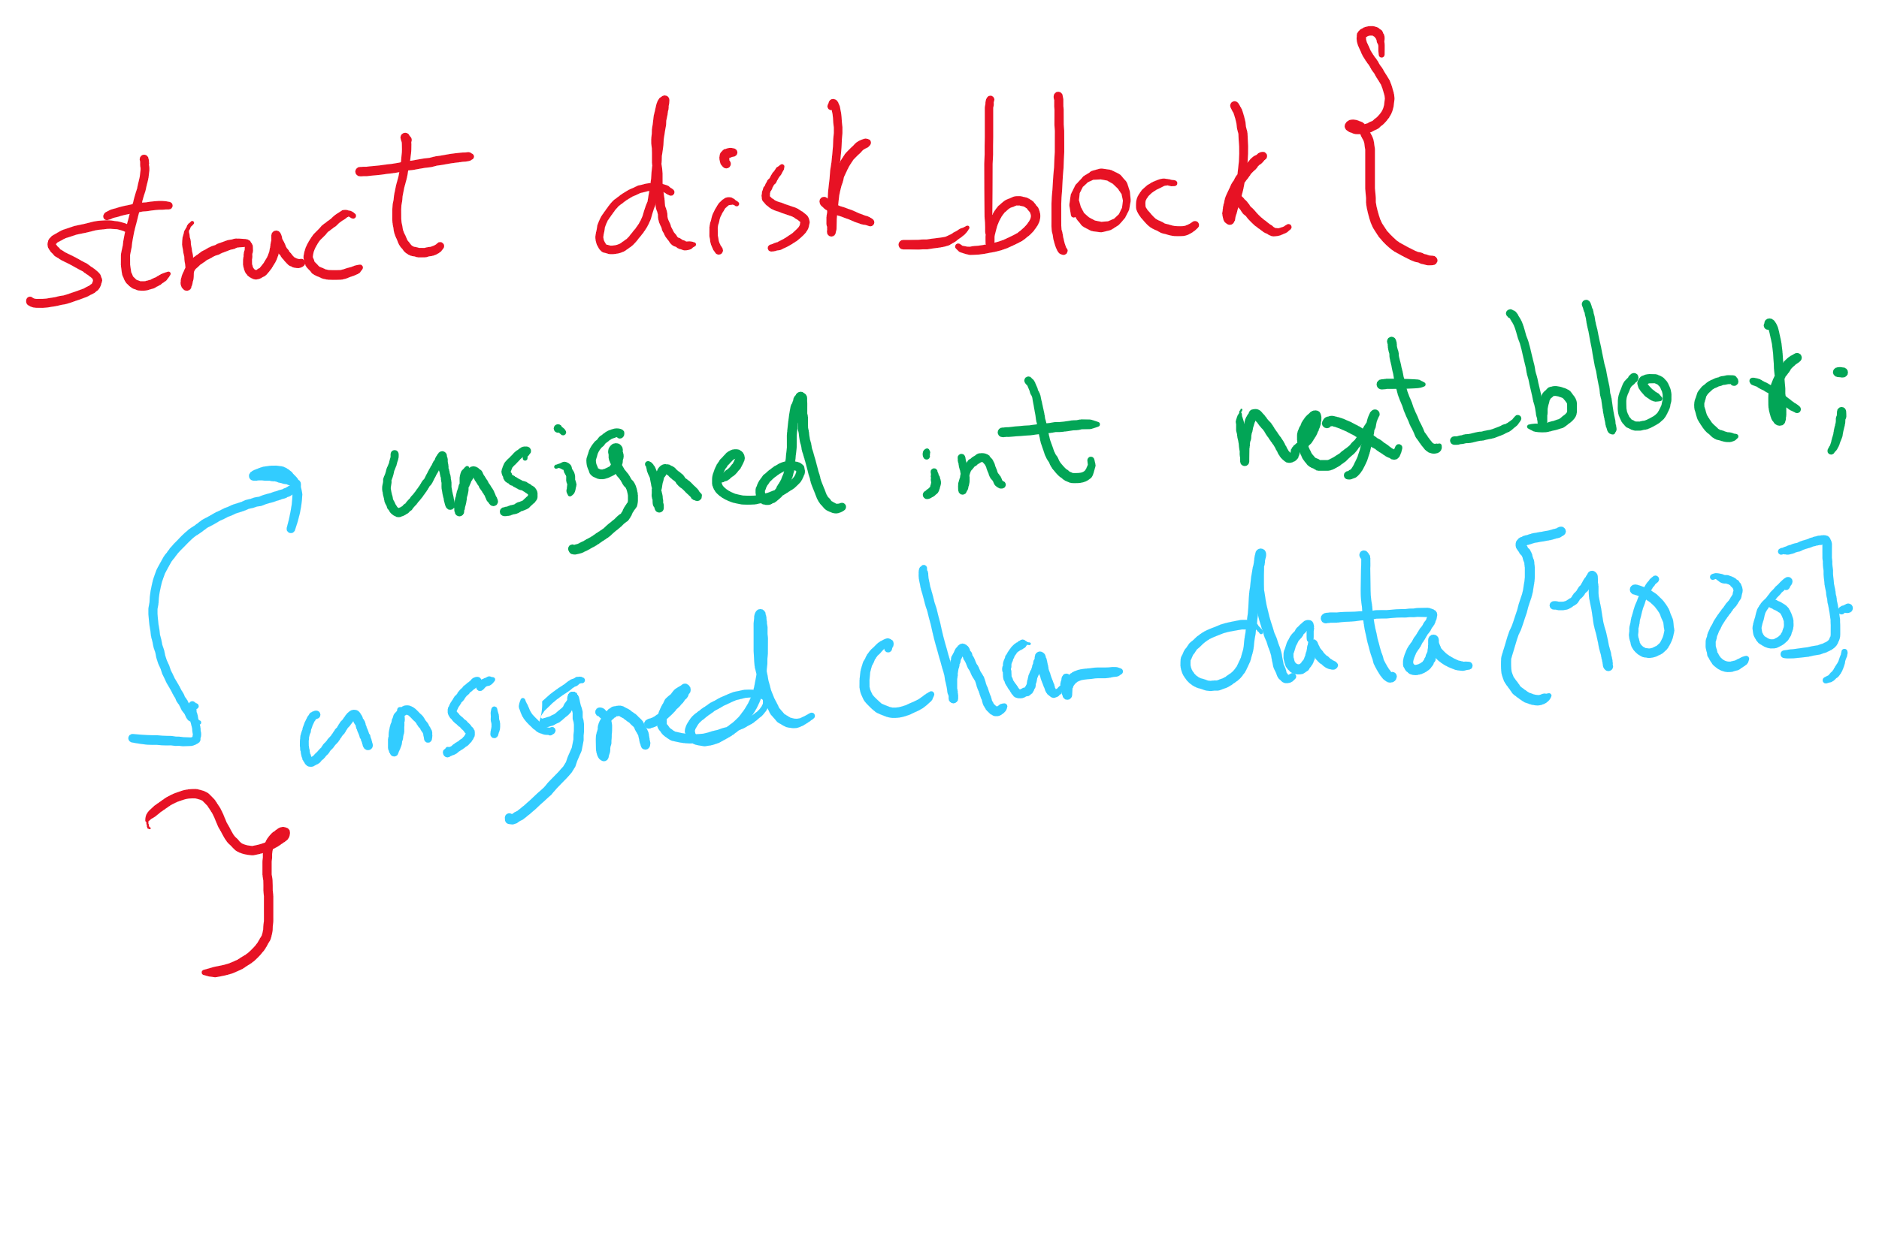
Data Structure for Linked Allocation

Slide 8
Logical to Physical Mapping
block = start logical_block_num = pos / block_size offset_in_block = pos % block_size for (j = 0; j < logical_block_num; j++) {
read disk block no. j into block block = block->next_block }
Assumes next block pointer stored at end of block. Why?

Slide 9
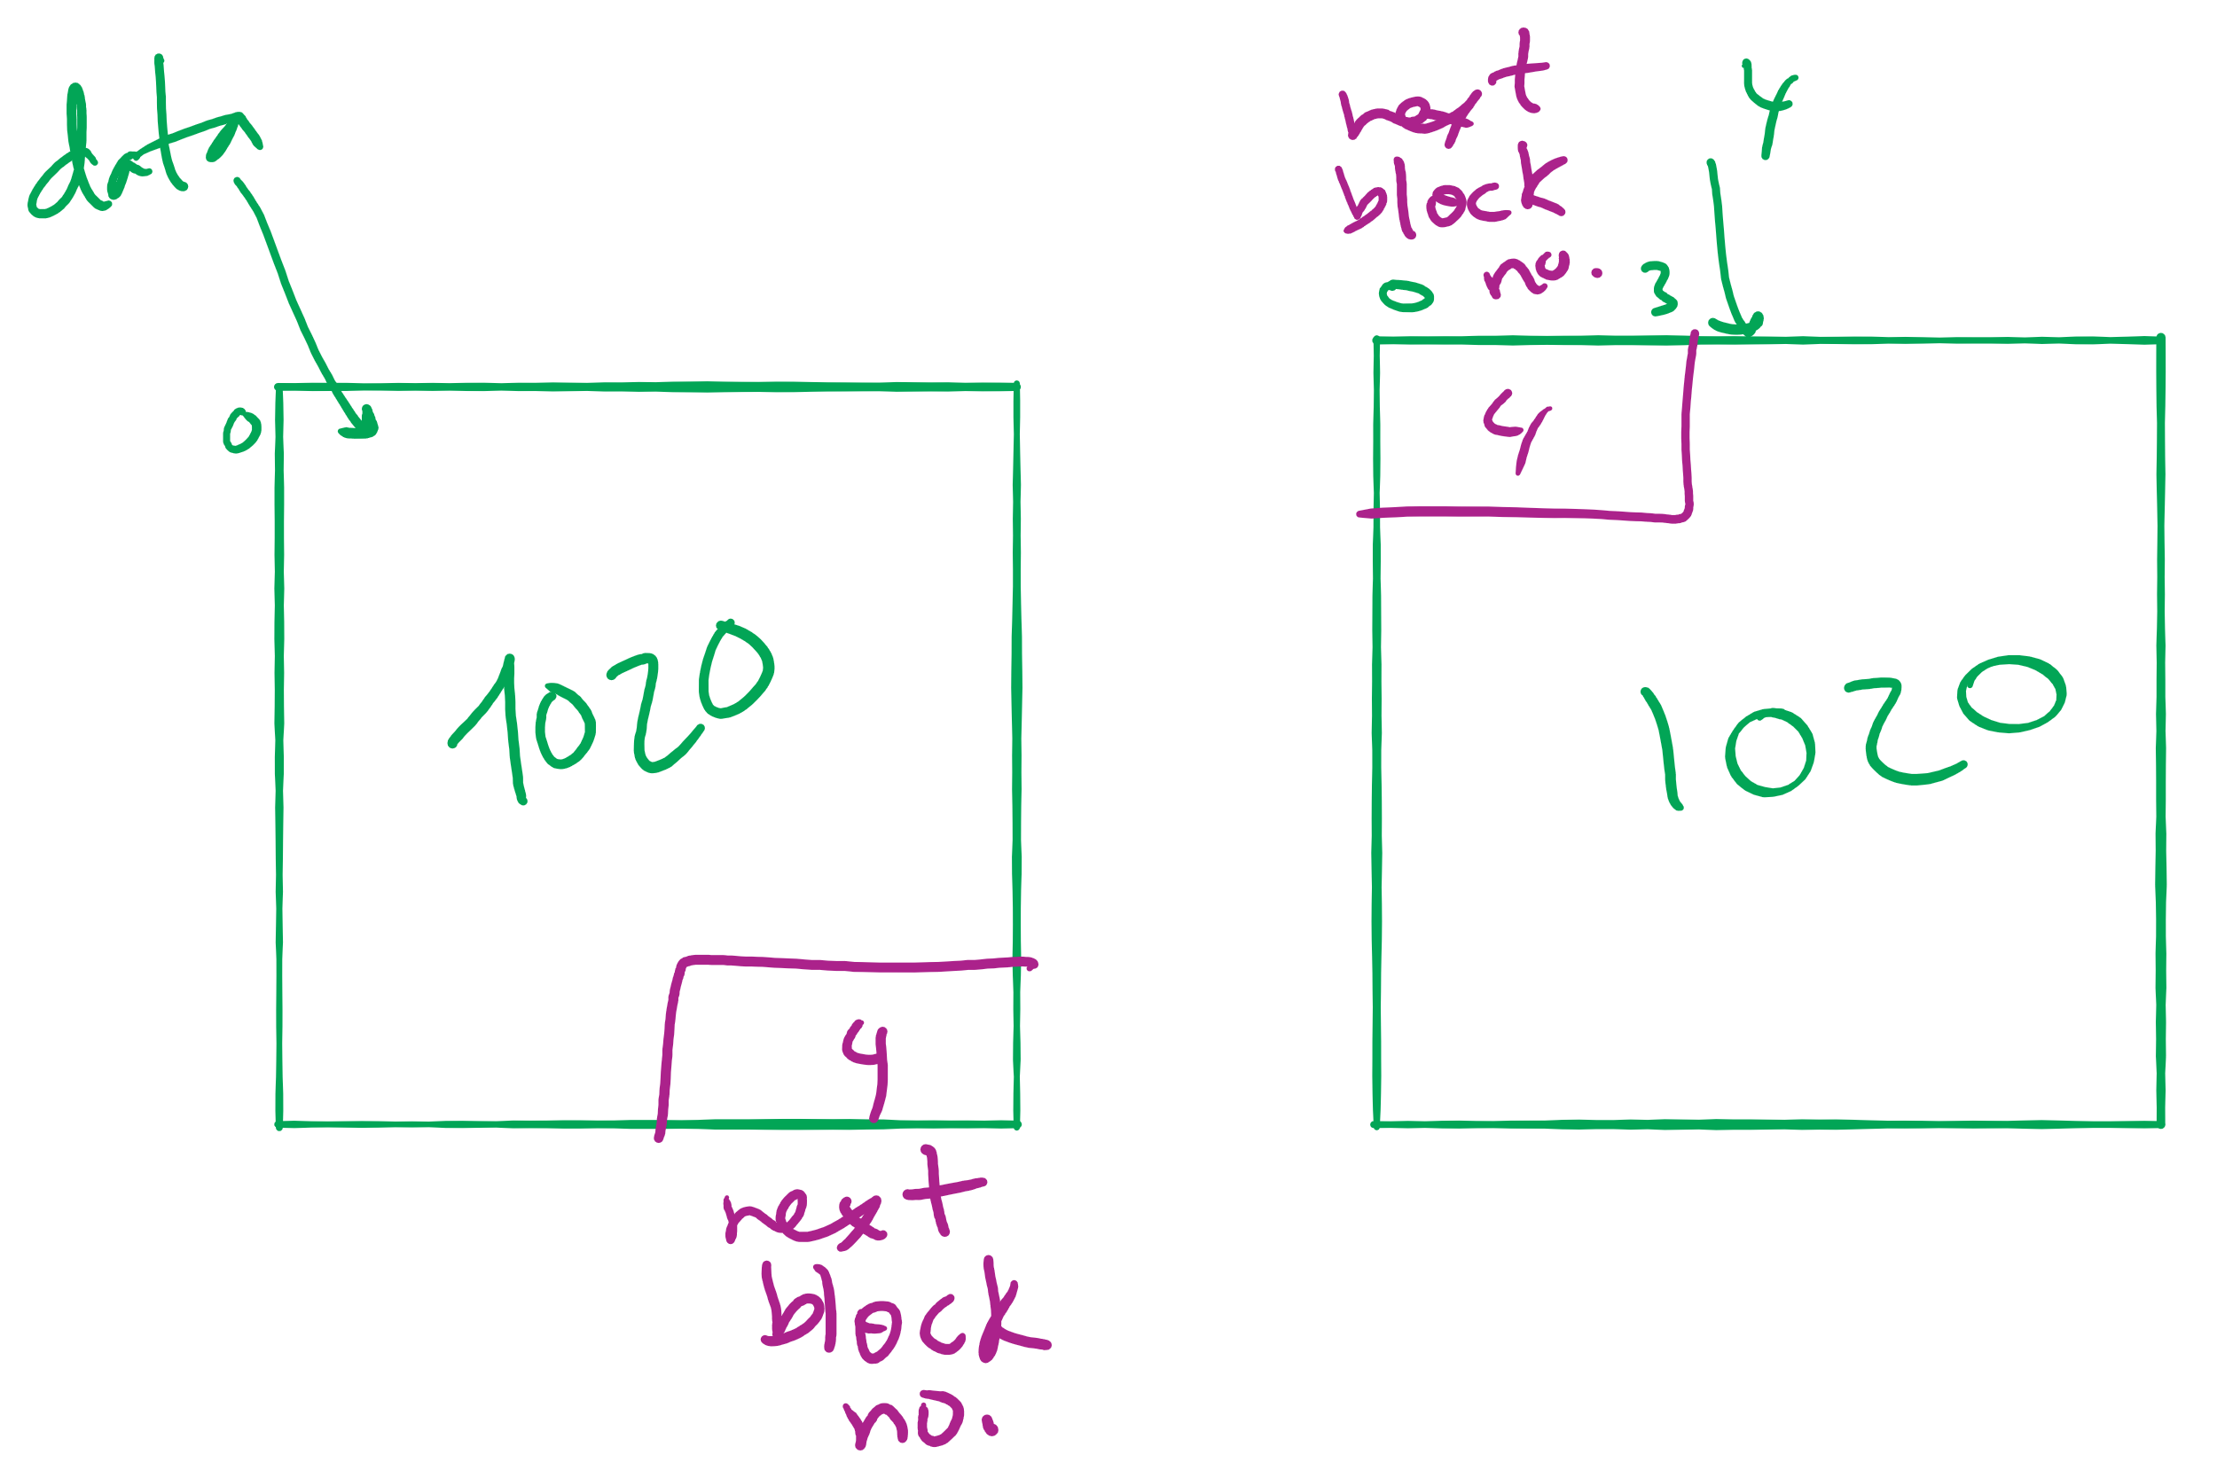
Offset Calculation

Slide 10
Linked allocation: Cons
Random access not possible
May require a long time for seek to random location in file
Overhead of next block pointers in each block

Slide 11
File Allocation Table (FAT)
Keep linked lists in memory
Advantage: faster
Disadvantages
Have to copy it to disk at some point
Have to keep in-memory and on-disk copy consistent
0
4
1
-1
2
-1
3
-2
4
-2
5
-1
6
3
B
7
-1
8
-1
9
0
A
0
1
2
3
10
-1
4
6
11
-1
4
5
6
7
12
-1
x
x
13
-1
8
9
10
11
14
-1
0
15
-1
File A
File B

Slide 12
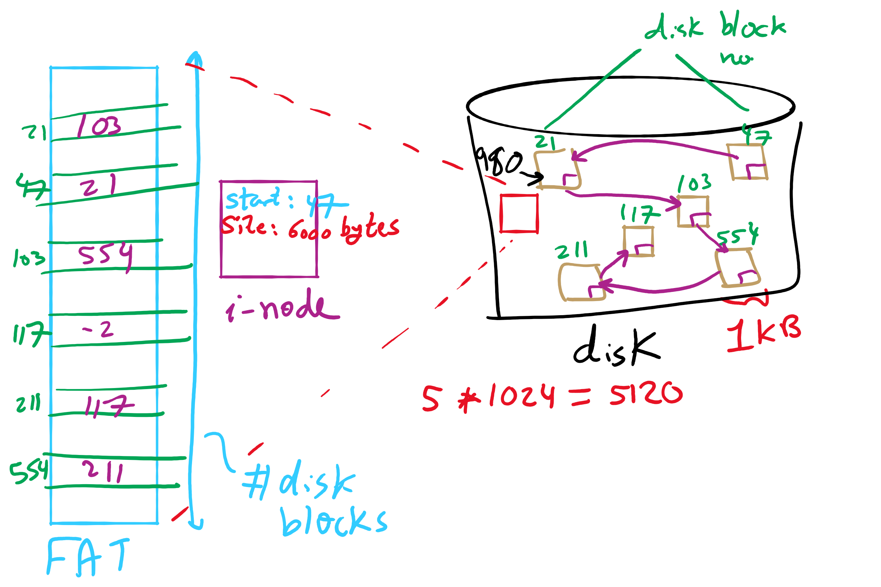
FAT Example

Slide 13
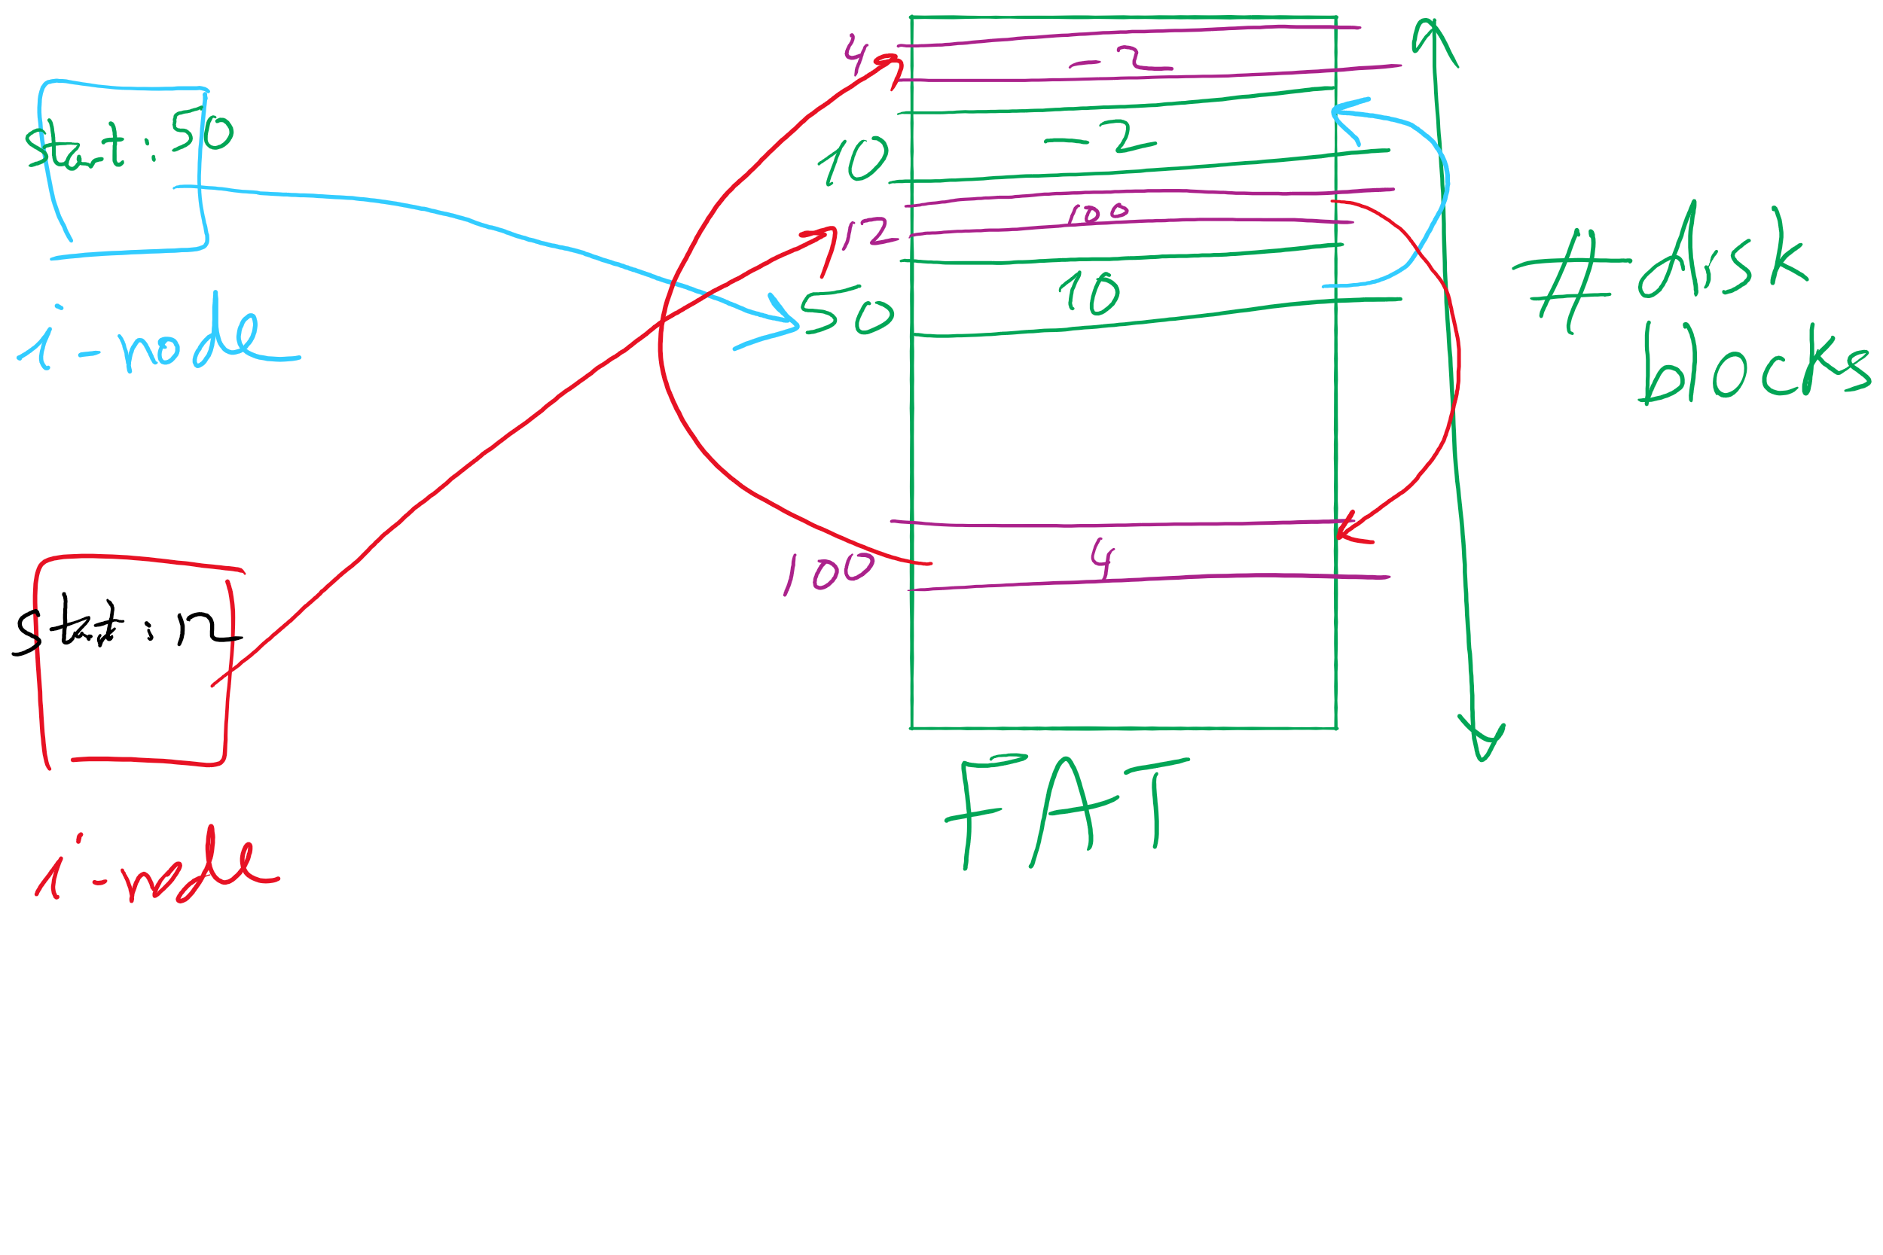
index nodes and FAT

Slide 14
Indexed Allocation
Store file block addresses in an array (called index)
Array itself is stored in a disk block
Index node has a pointer to index disk block
Non-existent blocks indicated by -1
Random access easy
Cons: Limit on file size!
Index Length
4 4802
0
1
2
3
6
9
7
0
8
4
5
6
7
8
9
10
11

Slide 15
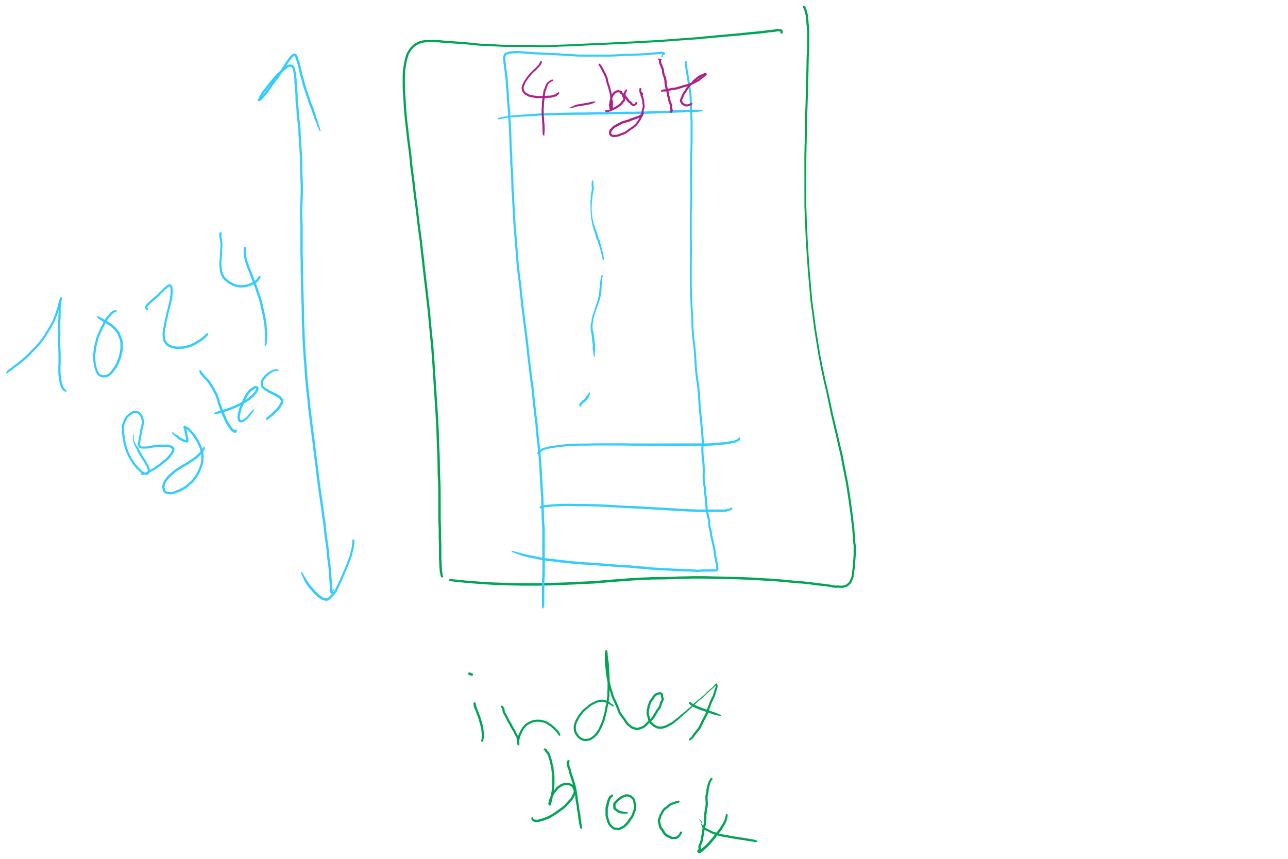
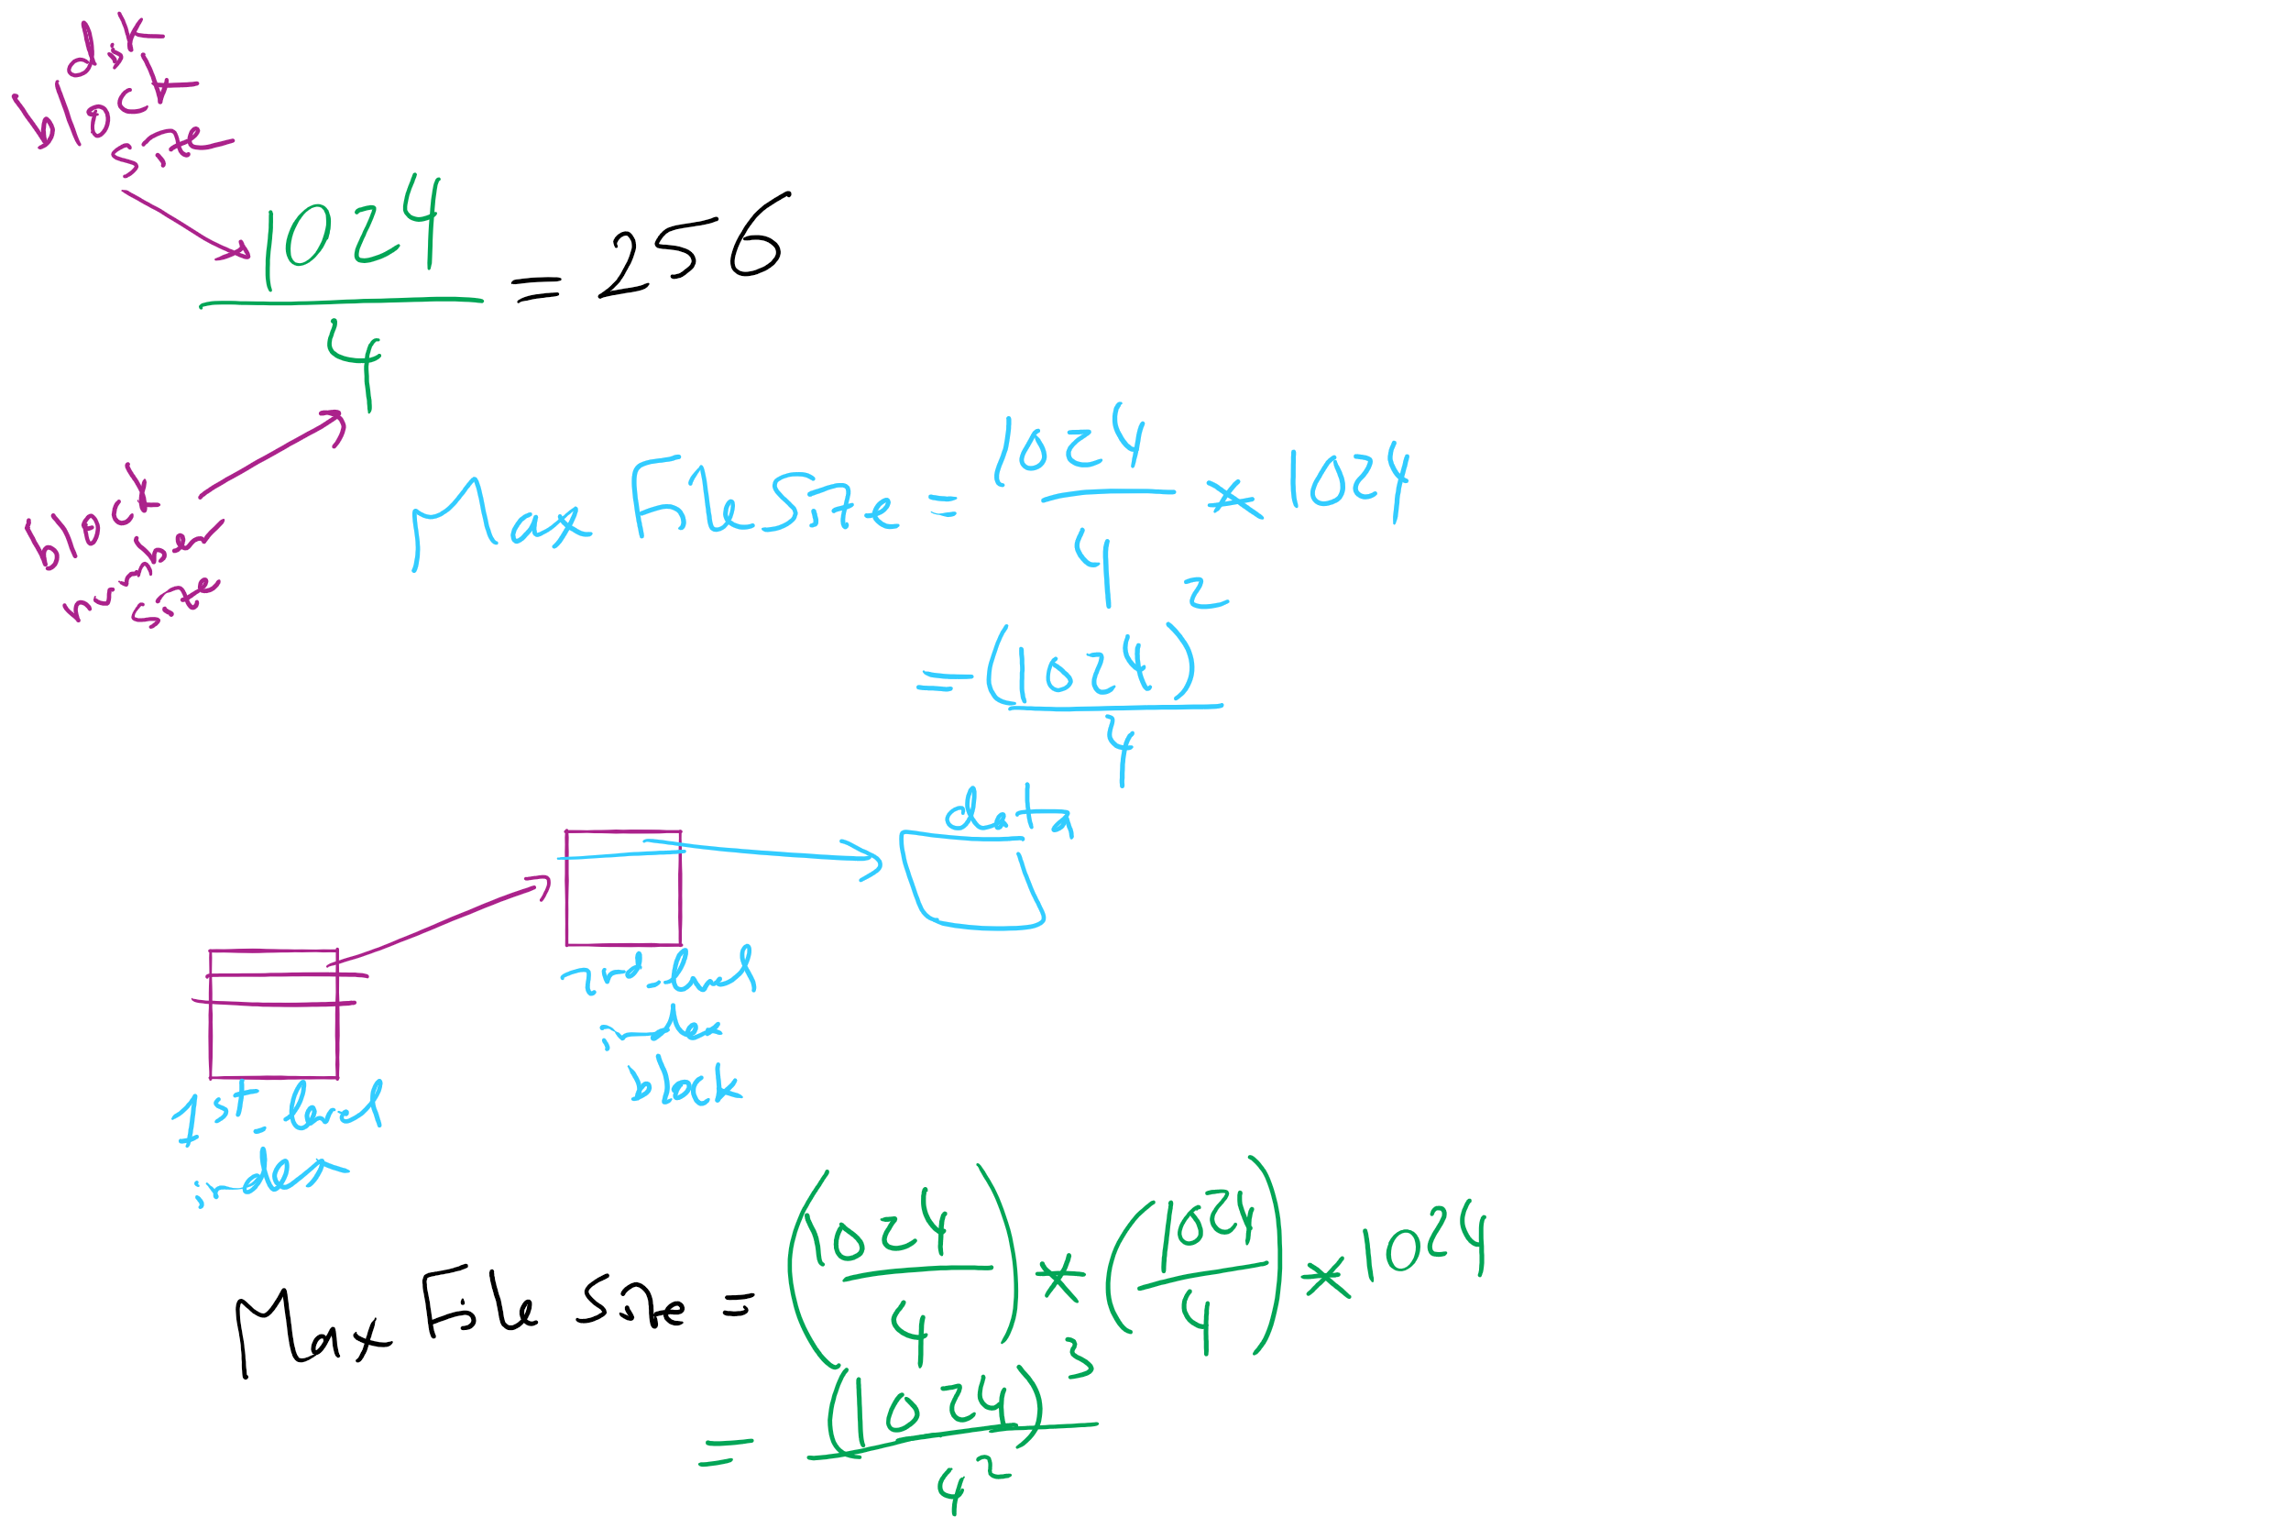
Max File Size for Indexed Allocation

Slide 16
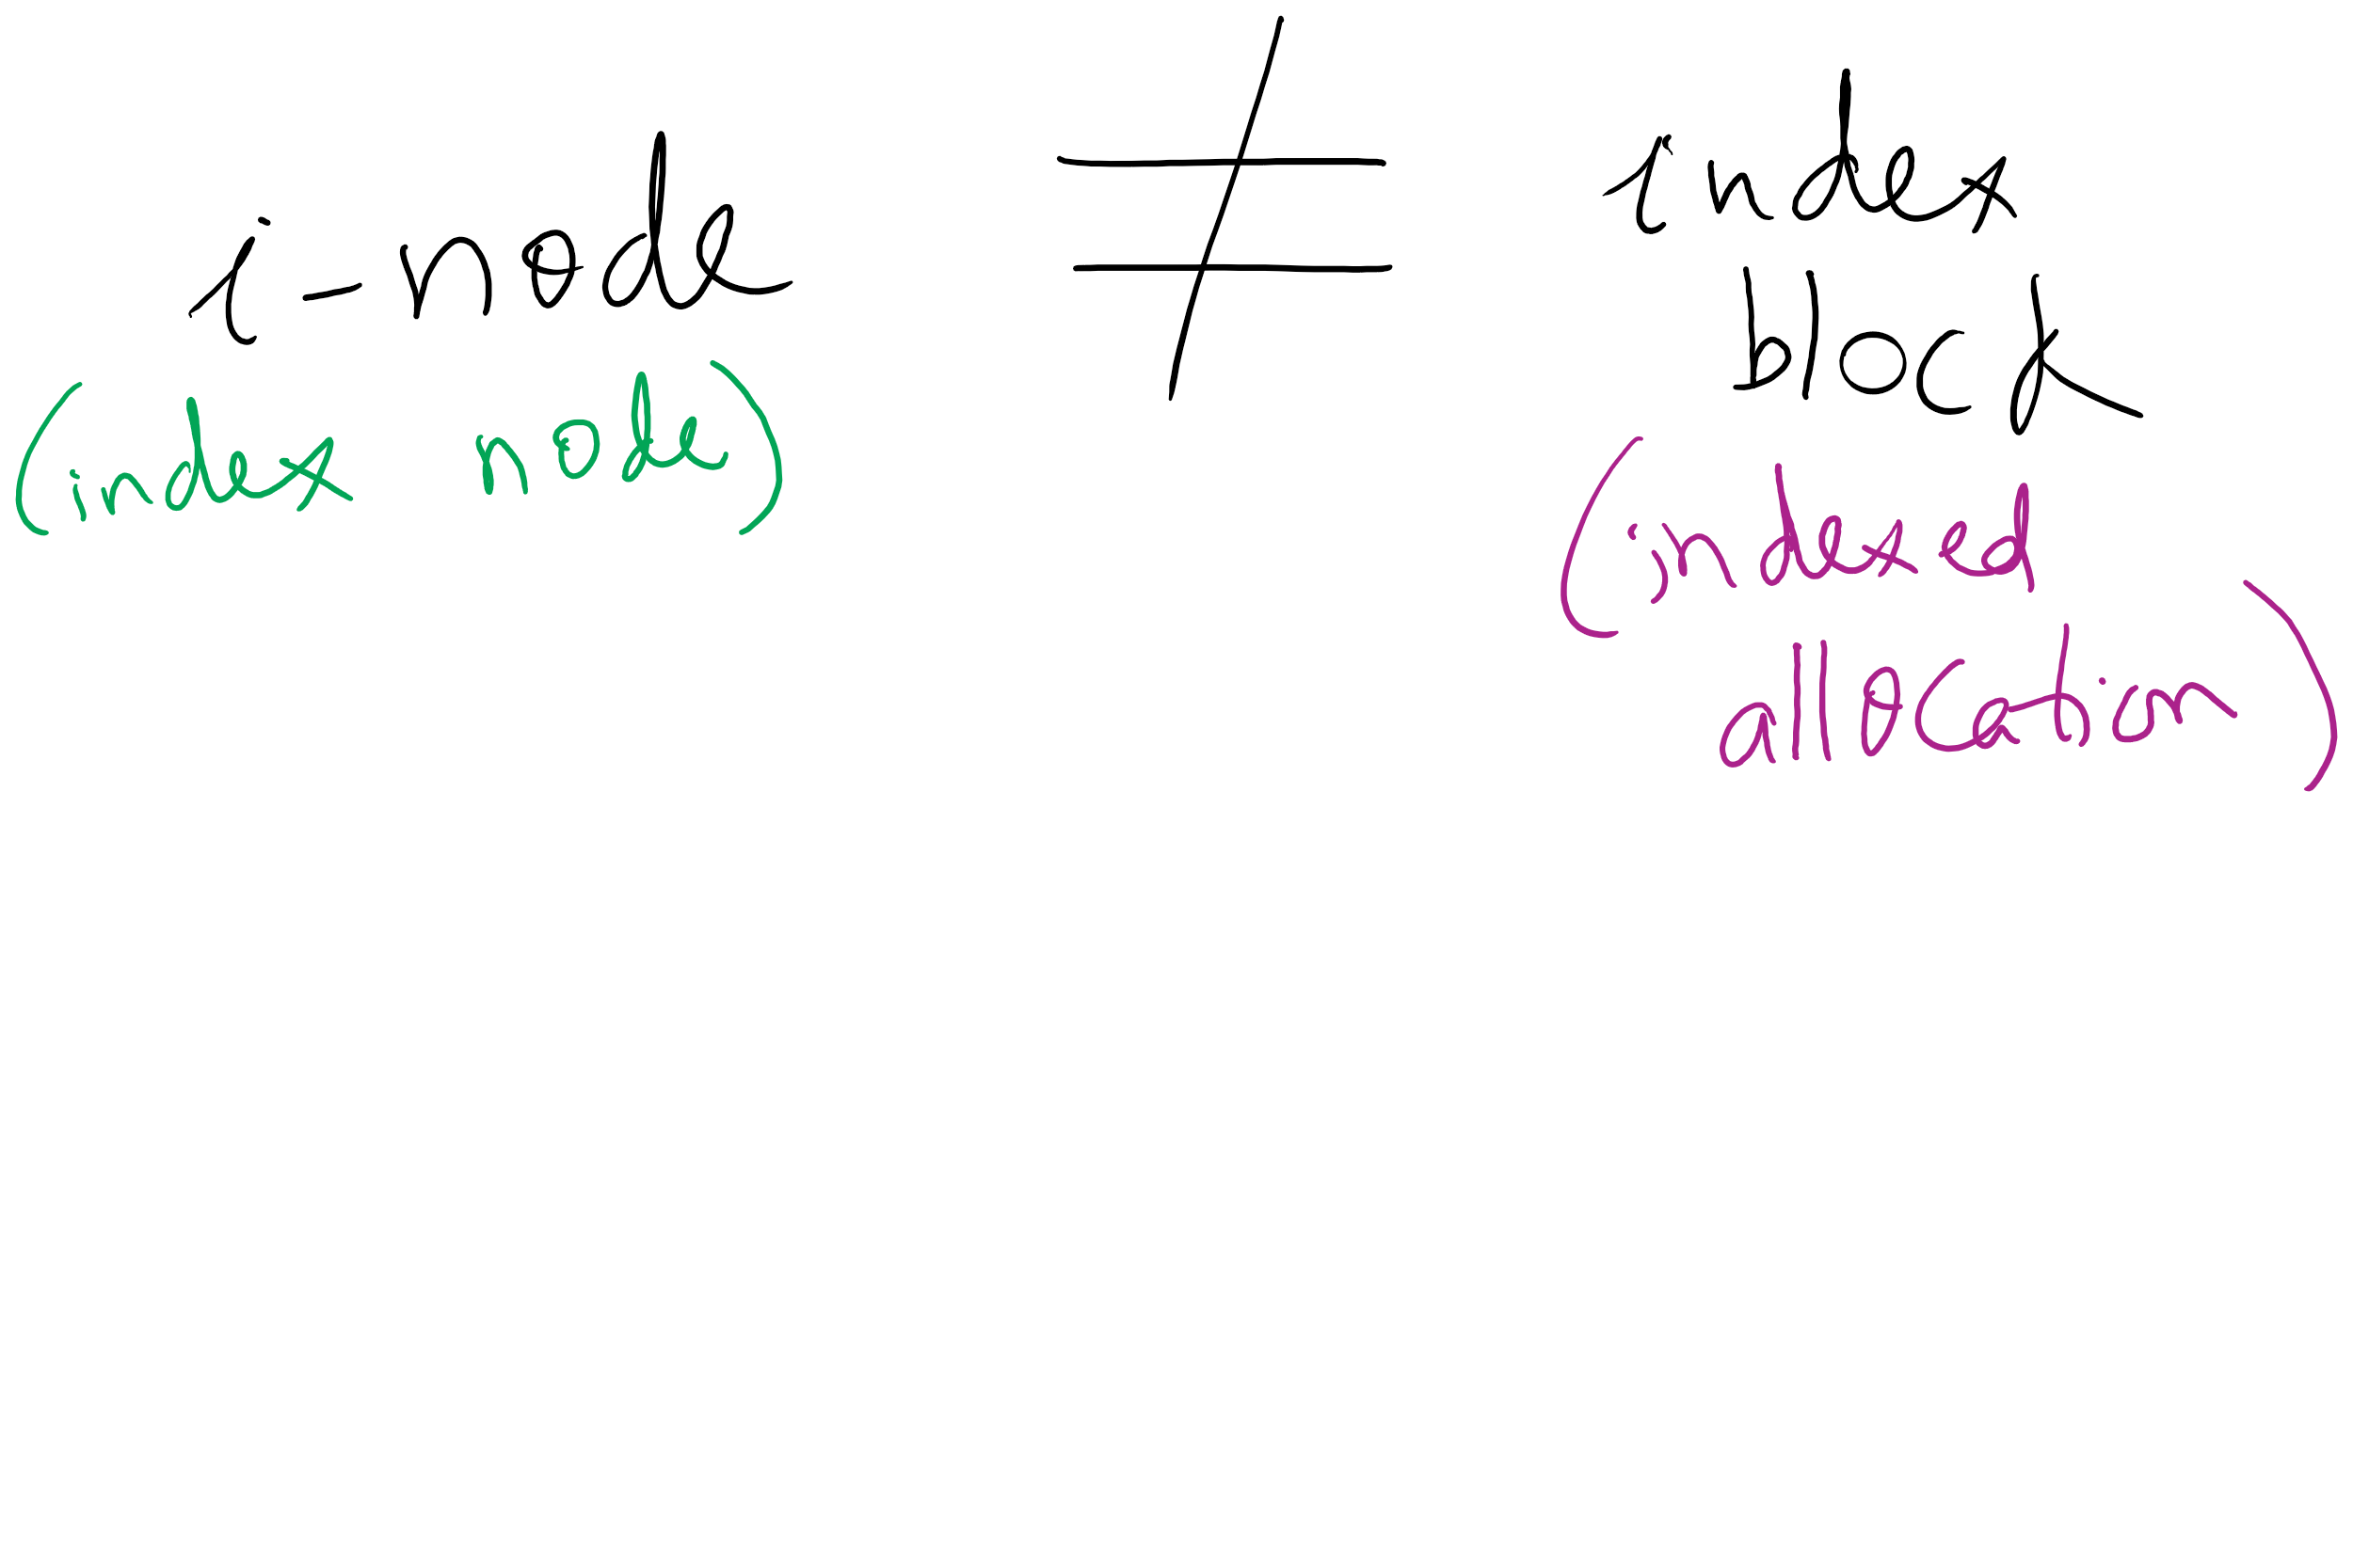
i-node vs index block

Slide 17
Hybrid Allocation (Lab 5)
Unix Fast File System indexing scheme
protection mode
data
owner & group
data
.
.
.
timestamps
size
data
block count
•
data
•
.
.
.
link count
•
Direct pointers
.
.
.
•
data
•
•
data
•
.
.
.
•
•
single indirect
•
•
data
double indirect
•
•
data
•
•
•
•
.
.
.
triple indirect
•
•
•
inode
•
•
•
data

Slide 18
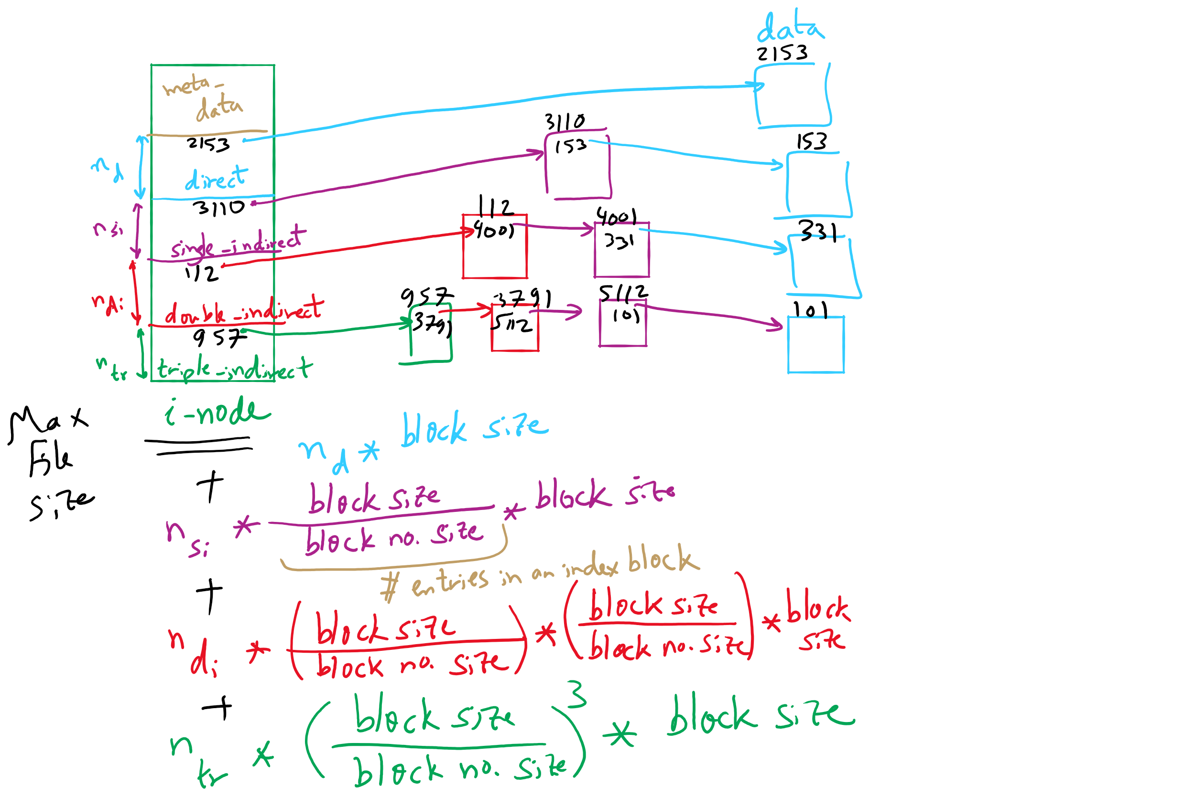
FFS Example

Slide 19
FFS and Max File Size

Slide 20
What’s in a file directory?
Two types of information needed about a file
File names
File metadata (size, timestamps, disk block locations)
Basic choices for directory information
Store all information in directory
Fixed size entries
Disk addresses and attributes in directory entry
Store names & pointers to index nodes (i-nodes)
attributes
games
attributes
games
mail
attributes
mail
attributes
news
attributes
news
attributes
research
attributes
research
Storing all information in the directory
Using pointers to index nodes
attributes

Slide 21
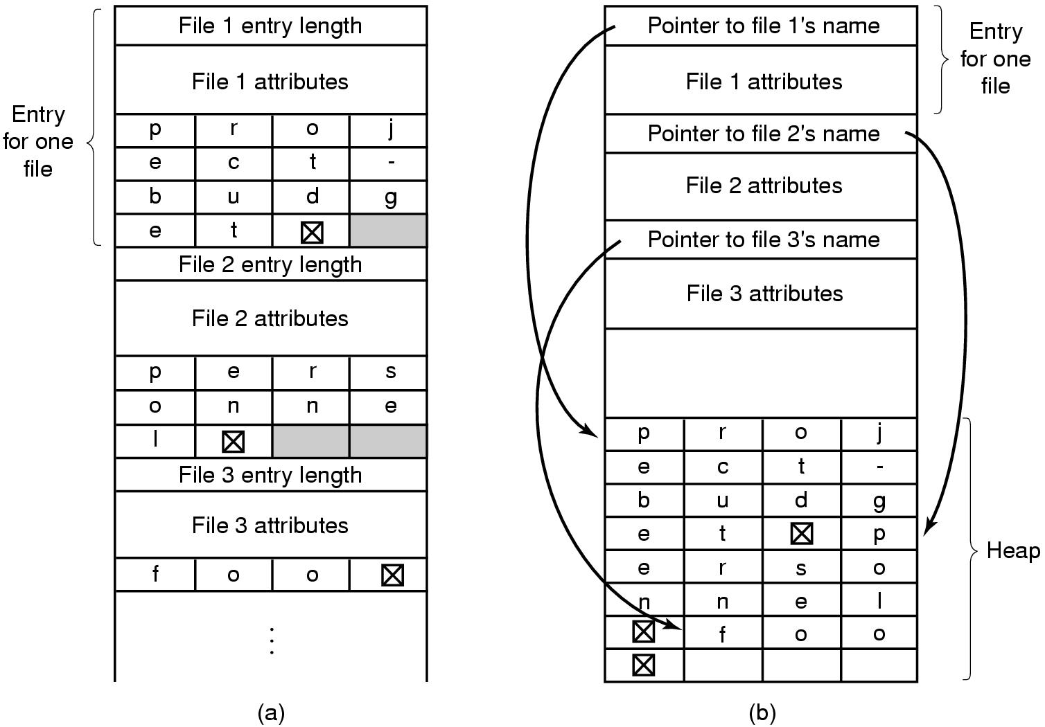
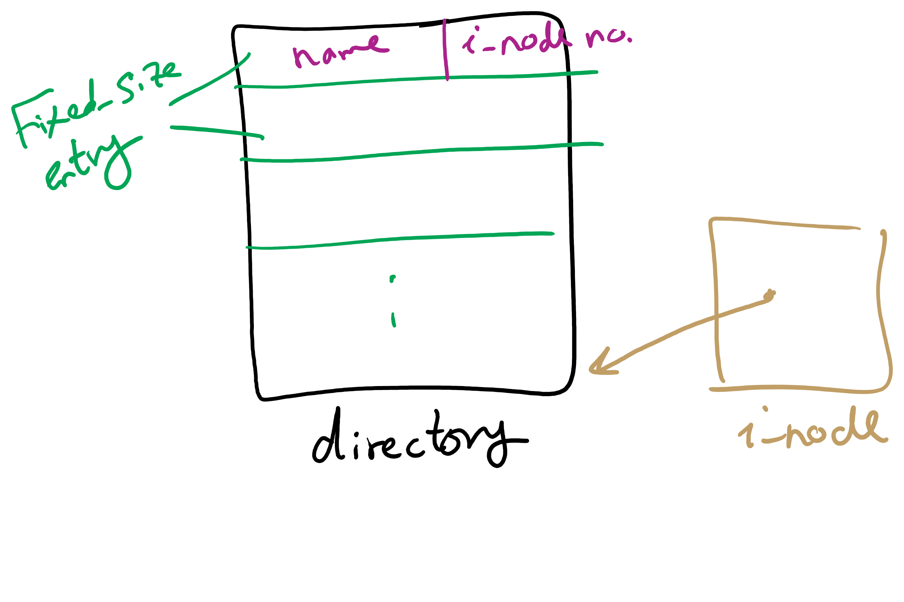
Handling long file names in a directory

Slide 22
Free Block Tracking
10

Slide 23
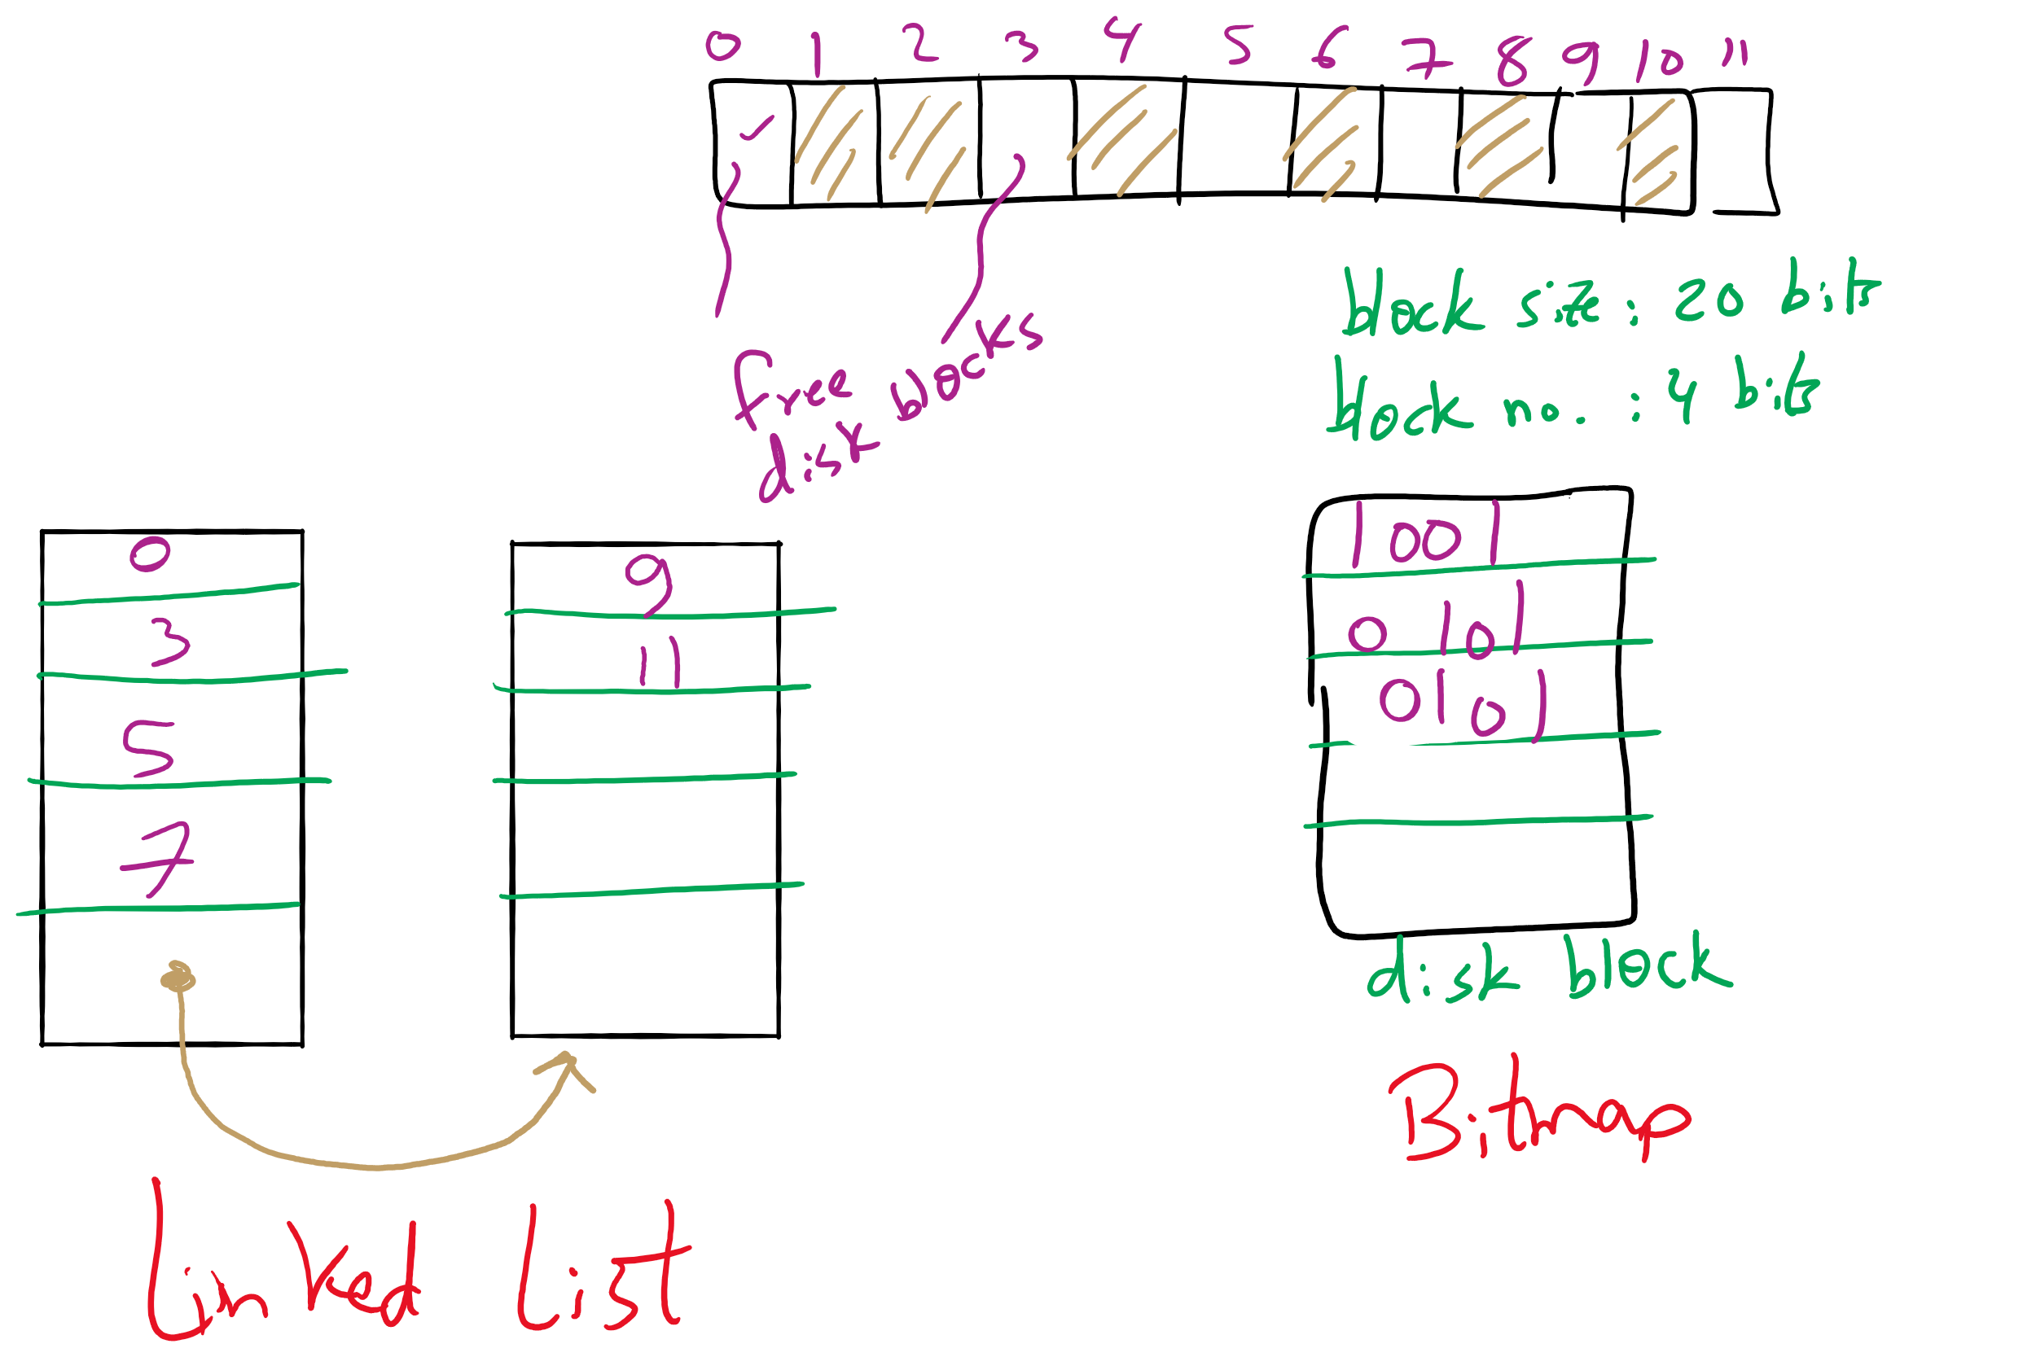
Free Block Tracking Example 1

Slide 24
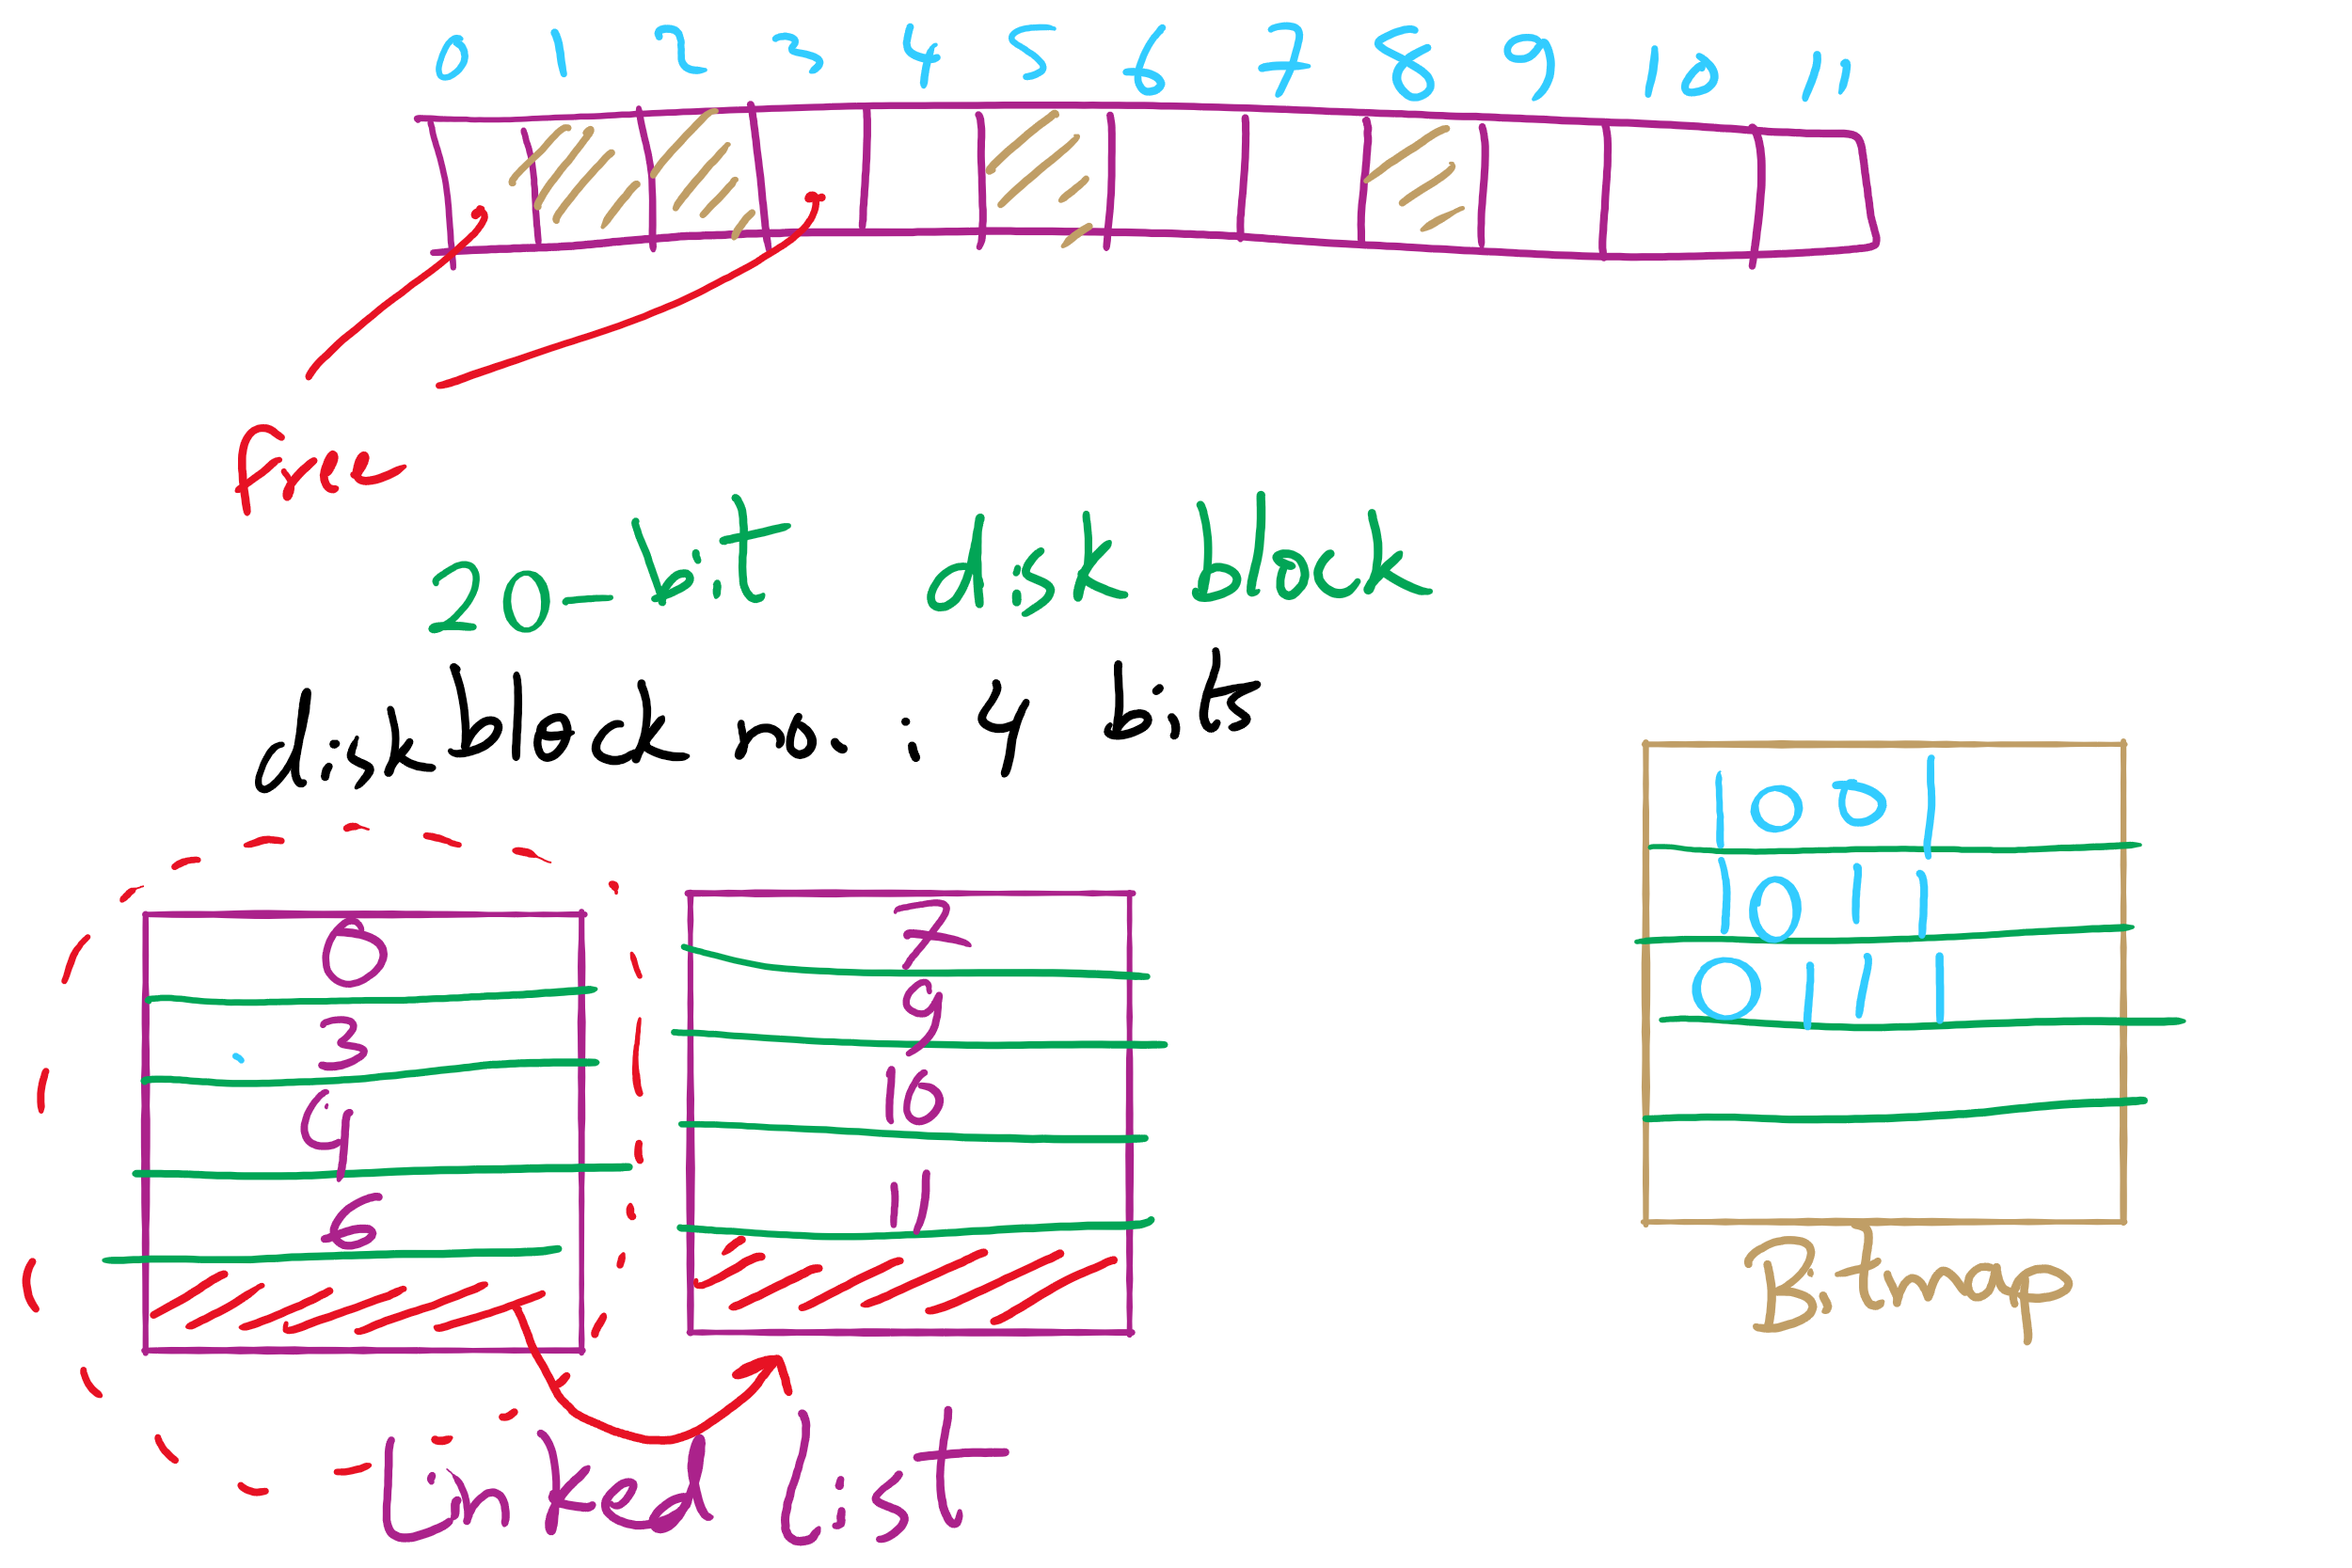
Free Block Tracking Example 2

Slide 25
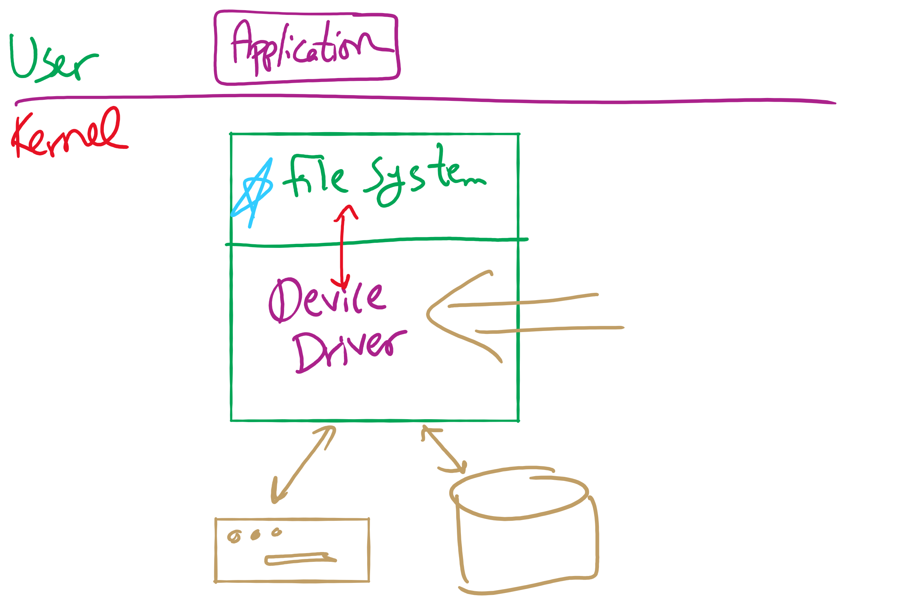
Software Layers

